Slide 1
Embedded 2 – Cosy cafetaria Presentation
By Tobias Cromheecke, Thomas Feys, Robin Van de Poel, Arthur Van den Storme
13-5-2020

Slide 2
Index
Introduction
System architecture
Power management
Microcontroller
Main PCB
Sensor design
Housing design
Wi-Fi communication
Software design
Power consumption
Dashboard
Validation and testing
Demo

Slide 3
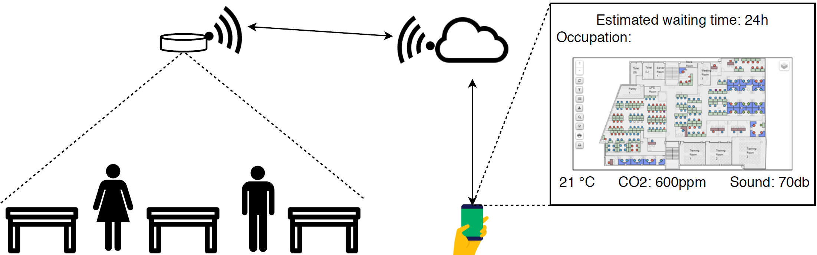
Introduction
Notes:
Volledige systeem eens bespreken zodat duidelijk is wat we willen bereiken

Slide 4
Specifications (only a few/most important)
Energy provision for 1 semester (4-5 months)
Must be rechargeable
Light weight: ~300 g
Measure new data every 10 minutes
Send the data website every hour (depending on changes in data)

Slide 5
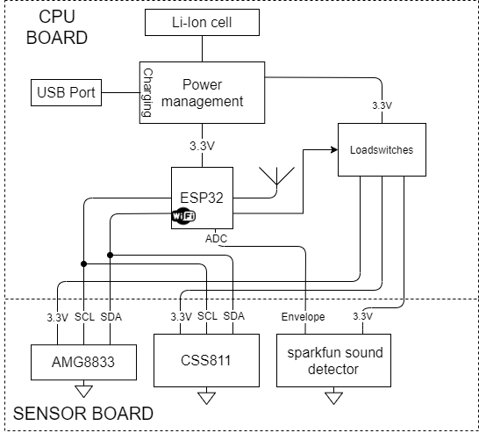
System architecture
Notes:
Overzicht van de hardware bespreken zodat het volledige beeld duidelijk is

Slide 6
Power management
Battery: Lithium-Ion battery
Protection IC
Charger IC via USB
Reverse polarity protection circtuit
LDO: 3,6 V to 3,3 V
Load switches to turn on/off the sensors
Availability to measure current

Slide 7
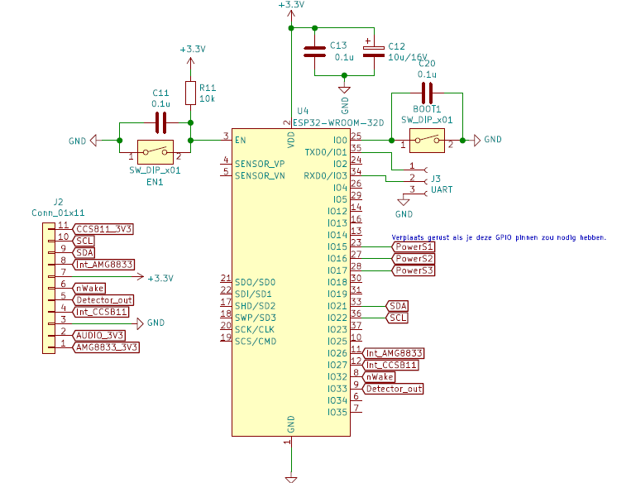
Microcontroller
ESP32 single core
Why?
Build in Wi-Fi module
Use enterprise network
Implementation
2 buttons for flashing the microcontroller
Notes:
The brain of our project is an esp32, this microcontroller was chosen becuase it has build in wifi which is capable of connecting to an enterprise network. This is necesarry if you wan’t to connect to the local wifi in the cafeteria.
To make it easier to use the esp32 two buttons have been added to the schematic, these are used to enable the programming mode on the device, with out them it would be hard to flahs the right software to the microcontroller.

Slide 8
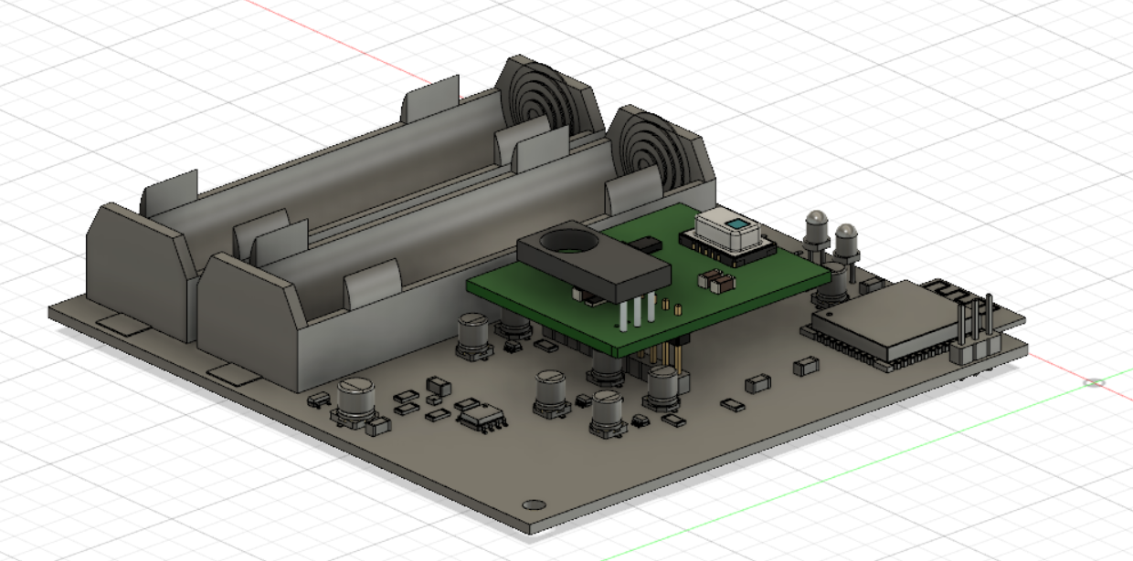
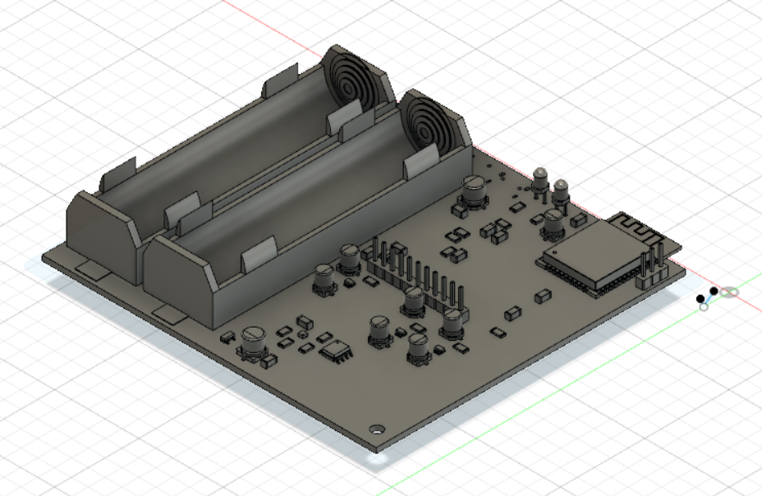
Main pcb
Pins to connect to sensor board
Power circuit
Batteries
10x10cm
Notes:
The main pcb is the place where everything comes together, it has the power circuitry on it, the holders for the two batteries, the microcontroller with it’s buttons and offcourse a pin header to connect to the sensor board. This pcb is roughly 10 by 10 cm big. Now I’m going to give the word to Robin.

Slide 9
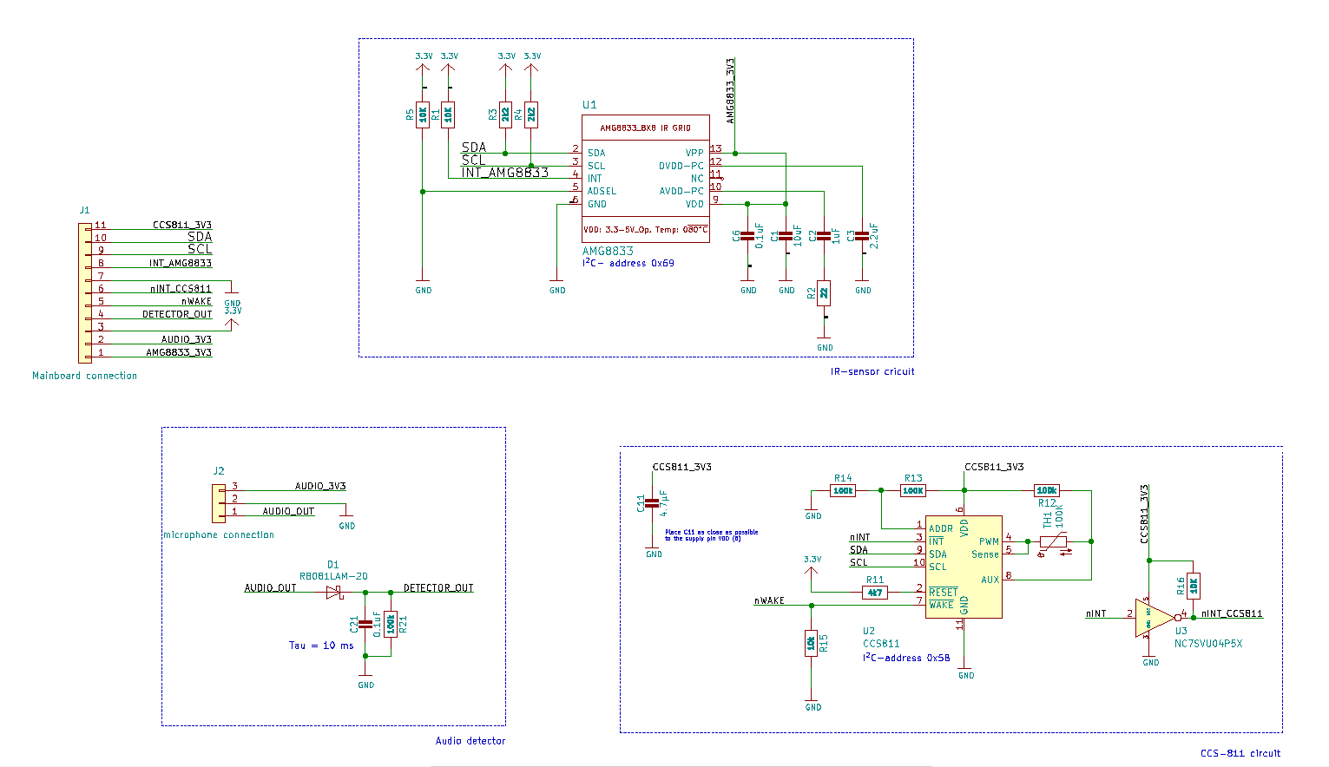
Sensor design
Completed:
PCB design of separate sensor board
Investigating response time of sensors
Bringing sensors
Functions: init, get data, sleep,…

Slide 10
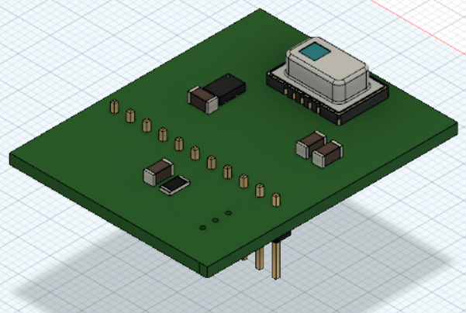
Sensors
AMG8833:
Measuring population of people
IR grid sensor with a 8x8 pixel raster
Extra functionality: ambient temperature
CSS811: air quality sensor:
CO2-level
Total Volatile Organic Compounds (TVOC)-level
Sparkfun sound detector: microphone
Amplifier circuit
Level detection by detector

Slide 11
Problems/limitations
Limitations due to corona measures
Correct cooperation of sensor board with the main board.

Slide 12
Housing design
Completed:
To do:
Discussing a basic idea of the housing
Getting the measurements of all available part
A tutorial on 3D-printing design with fusion360
Design of housing
Checking if hardware fits the housing

Slide 13
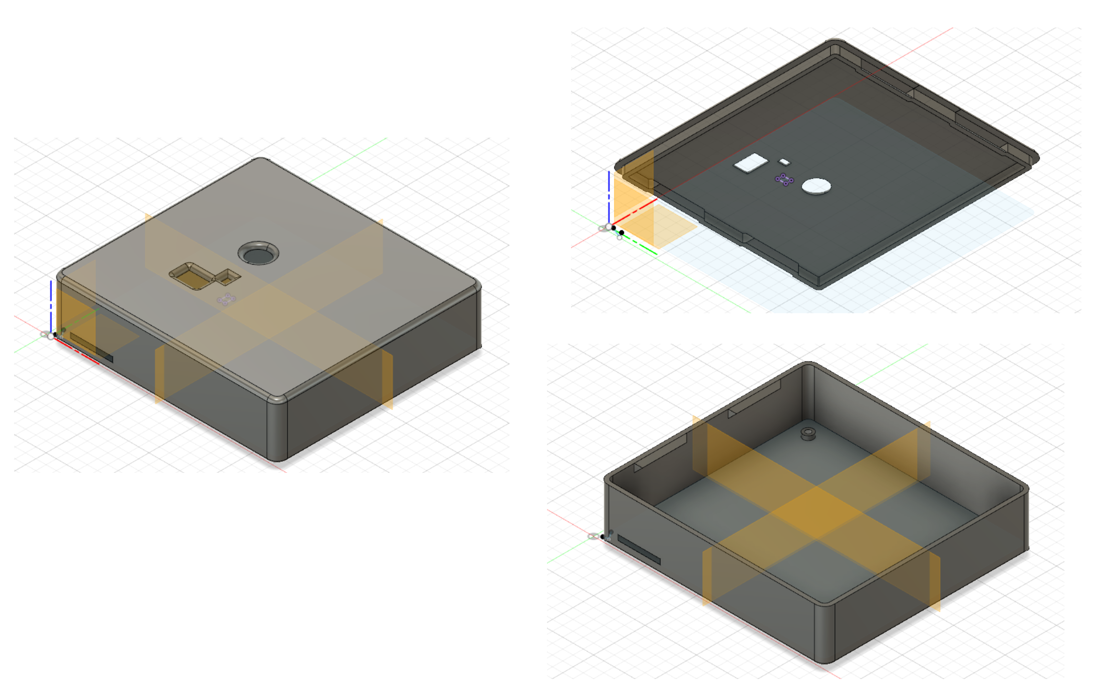
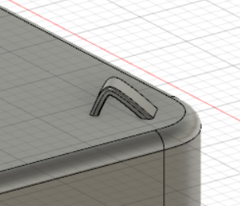
Housing
Assembly
Easy accessibility
Snapfits
Only 2 screws
Mounting system
Cable suspension to sealing
Loop at each corner
Openings
Sensors
Wifi-antenna

Slide 14
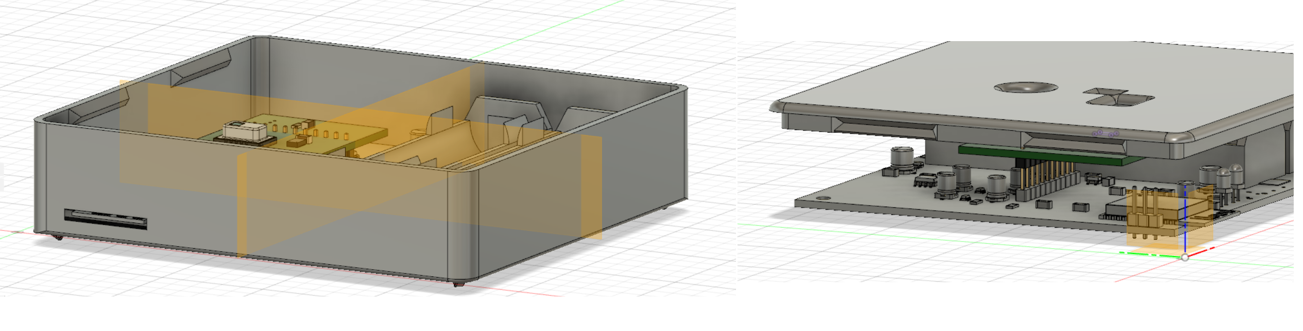
Problems/limitations
Delay on delivery housing
Due to corona pandemic
Fitting design housing not possible

Slide 15
Wi-Fi communication
TCP connection between ESP32 and Python server
Python server on Raspberry Pi
Server updates SQL database with received data

Slide 16
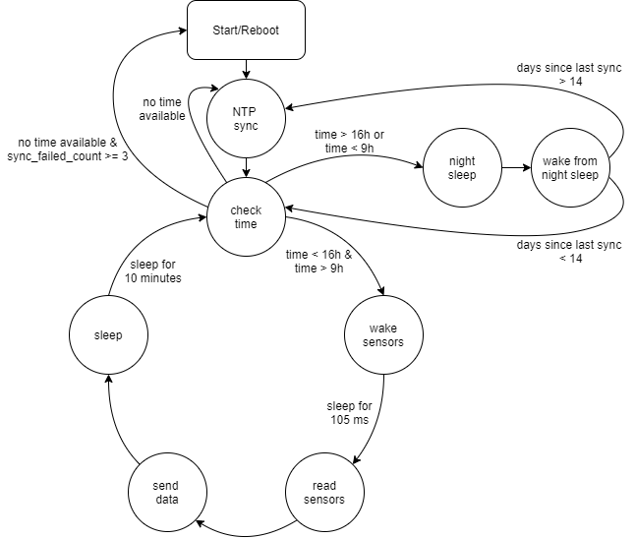
Software design
Functionality:
Pull sensors from sleep every 10 minutes and read sensor values
Send sensor data to Python server, over Wi-Fi
Perform periodic synchronisation to get time information
Use time information to disable power to sensors and put CPU in deepsleep during night (4 pm – 9 am)

Slide 17
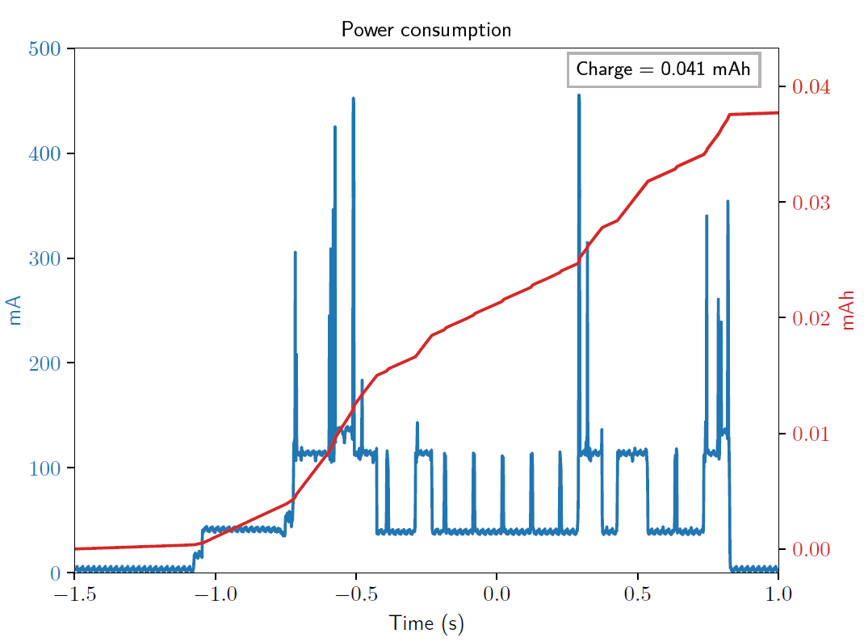
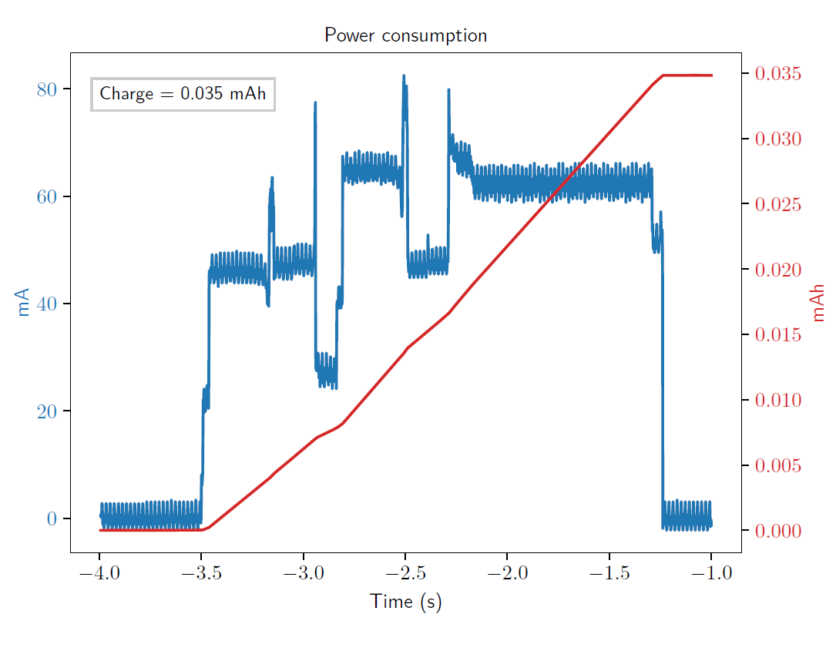
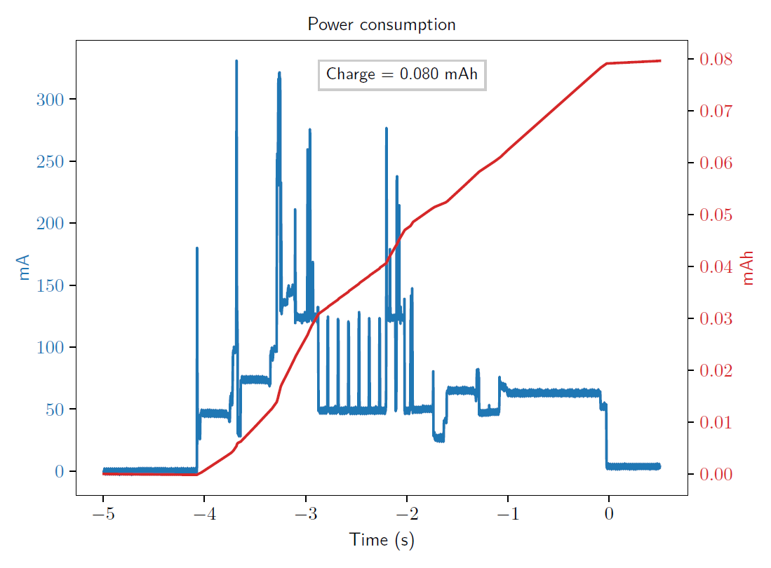
Power consumption
Consumption sources
Wi-Fi communication
Sensor measurement
NTP synchronisation
Standby consumption during daytime
Standby consumption during night-time

Slide 18
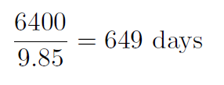
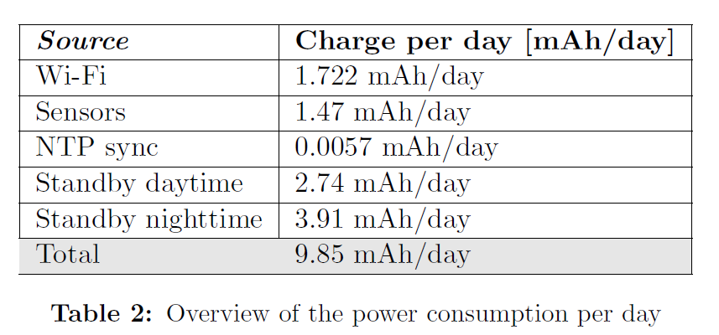
Power consumption
Power consumption per day:
Not taken into account:
9.85 mAh/day
=> Battery life =
Self discharge battery
quiescent current voltage regulator
quiescent current load switches

Slide 19
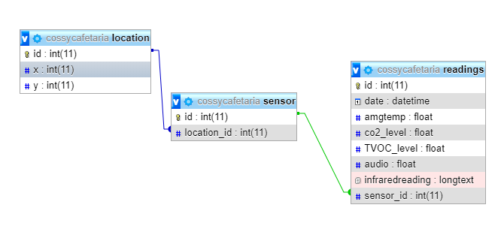
Dashboard
Backend
Raspberry Pi as server
Python script to recieve data
Mysql database
Apache2 webserver
Notes:
The goal here was to make a simple website that displayed the data from all the sensor nodes that would be placed around the cafetaria, first i’m going to talk about the backend or server side. A raspberry pi is setup up as the server the recieves and saves the data, it also hosts the website. To recieve the data a python script that runs in the background is used. The recieved data is then saved in a mysql database. The schematic of this database is displayed in the figure. You can clearly see the 3 colums, one for the location of the sensor, one for the sensor itself and the final and most important one. The one where all the sensor readings are stored. To host the website apache two is used.

Slide 20
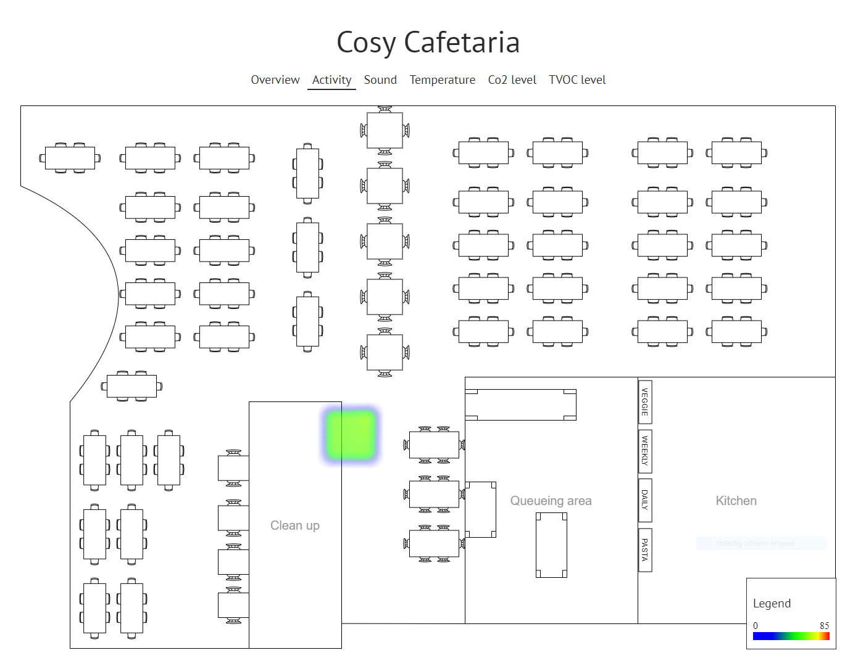
Dashboard
Frontend
Website
2 different types of pages
Overview
Heatmap
Notes:
The second thing I'd like to tell you about is the frontend of the dashboard, this is a website with two different pages, one is an overview page here the average from all the sensors is displayed so that any one can see how warm, noisy or busy the cafeteria is. The second type of page is a page that displays all the sensor data from each sensor node individually, a heatmap is used to display this data, the example of the infrared camera is show in this picture, you can clearly see the colored in square that display every single pixel individually. Now i pass the mic back to thomas.

Slide 21
Validation and testing
Equipment:
ESP32-DEVKitC
AMG8833 break-out board
CCS811 break-out board
Raspberry Pi to host the server, database and website

Slide 22
Validation and testing
Successfully validated:
To validate:
Software
AMG8833
CCS811
Hardware: power management, load switches, sensor board, ESP32 board
=> Software is fully functional
Notes:
The correct functionality of the software has been tested by uploading the code in the development kit.
The sensor data of the ir sensor and the airquality sensor was succesfully updated every ten minutes.
Then the sensor data was succesfully transmitted to the server that was running on the raspberry pi, the values in the sql
Database were succesfully updated.
The only sensor that couldnt be tested is the microphone, because no break-out board was availible. However, the microphone produces an analog signal that
Has to be captured with the adc of the esp32 this was tested by connecting an analog ouput of the esp32 to the adc.
Next to the sensors and the datatransfer, the system was tested for 1 full day to verify the timing that is used. The system could perform the ntp synchronisation
Succesfully and went to deepsleep once it was past 4 pm

Slide 23
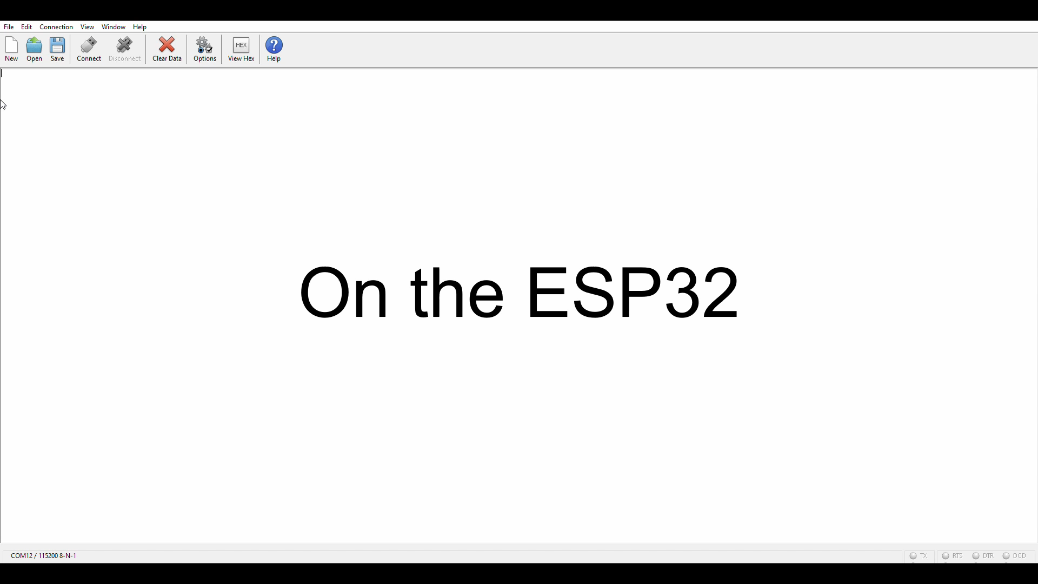
Demo

Slide 24
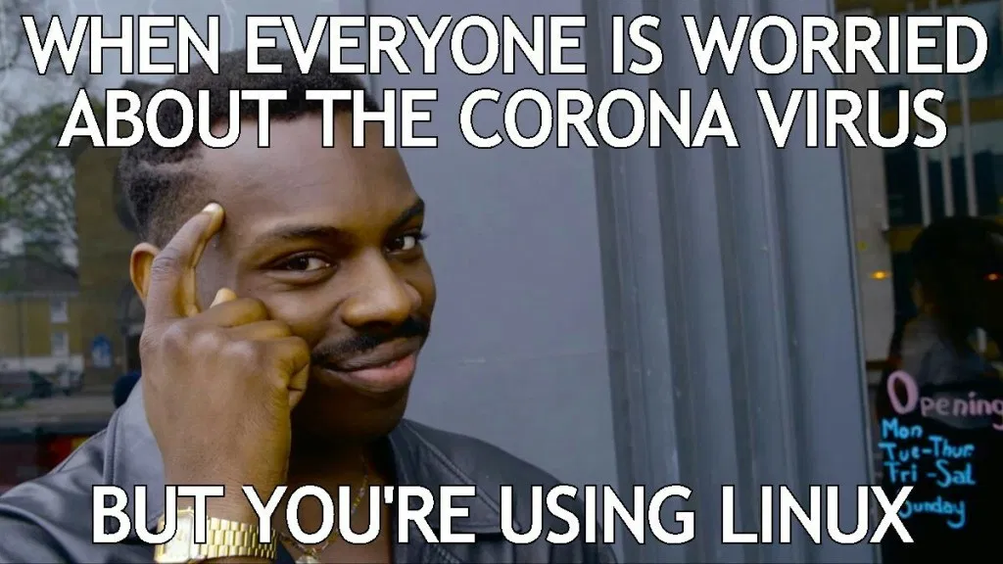
Conclusion
Despite corona fully functional end product
Final test on developed hardware necessary
Notes:
Fully functional end product that was tested on devkits and break-out boards

